Slide 1
Plenary Session: Putting Single-Payer at the Forefront in the 2016 Election
Andy Hyatt and Janine Petito
Political Advocacy Team Co-Chairs
Boston University School of Medicine

Slide 2
Plenary Overview
2:30-2:50 - Single-Payer and the 2016 Elections
Overview of SNaHP’s election-year strategies
3:00-3:55 - Pick a Training!
Bird-Dogging (208)
Legislative Advocacy (202)
4:00-4:45 - Regional Planning

Slide 3
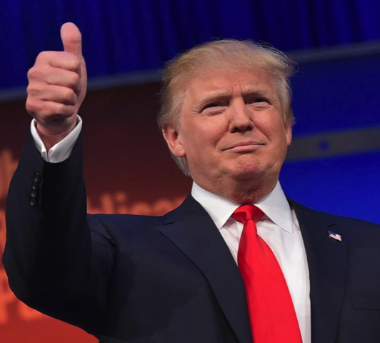
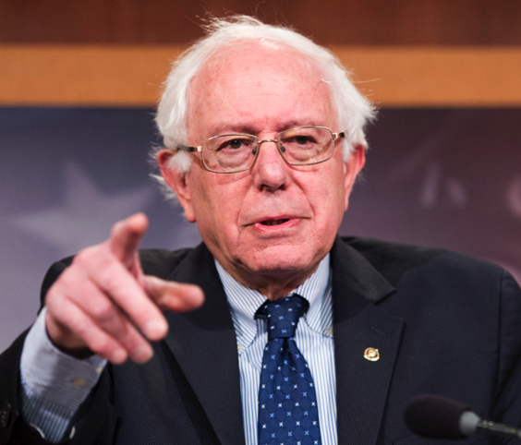
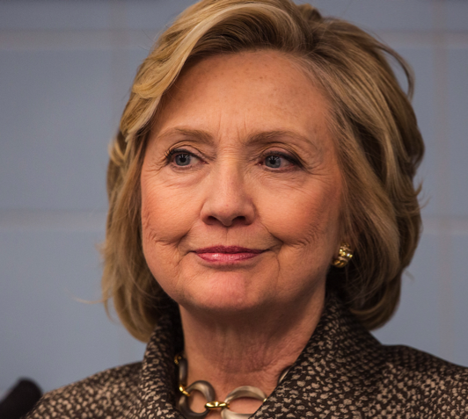
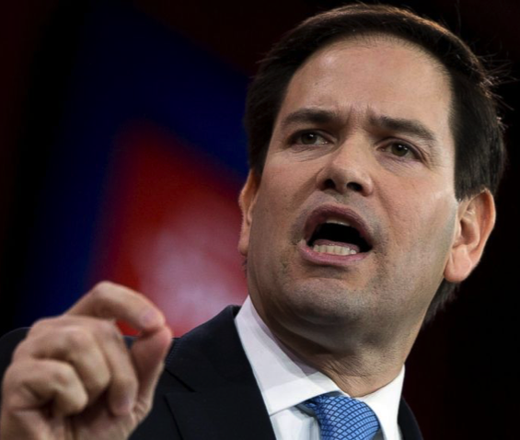
Single-payer and the 2016 Elections
Notes:
Everyone knows who these people are right?
Trump, Sanders, Clinton, and Rubio

Slide 4
Three Basic Positions on Healthcare
Repeal the ACA, replace with unspecified “alternative”
Improve/Expand the ACA
Single-payer, a.k.a. “Medicare-for-All”
…
4. Whatever the hell Donald Trump is proposing
Notes:
Repeal the ACA: Rubio, Cruz, entire GOP field
Commonalities: Block grant (cut) Medicaid, privatize Medicare, shift everyone to high deductible health insurance
Improve the ACA: Clinton
Possibly allow Medicare to negotiate drug prices, use tax credits to cap out of pocket expenses
Mum on covering the rest of the uninsured, realistic plan to combat the rise of increased “skin in the game”
single-payer: Sanders
Run on a “Medicare for All” platform, funded by payroll taxes with additional contributions from higher marginal rates on the wealthy
No seriously who the hell knows what Trump would do

Slide 5
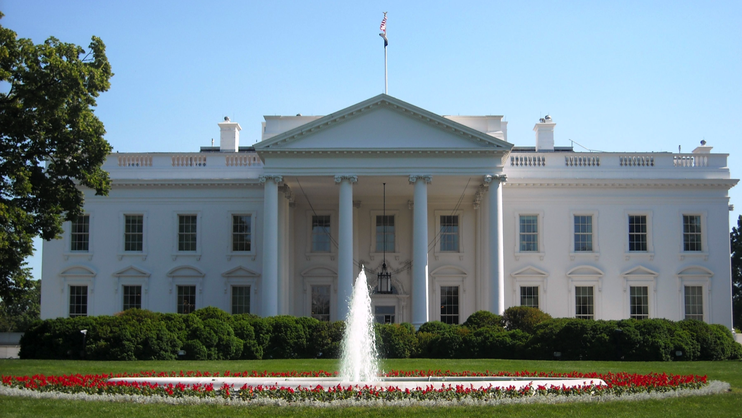
Now you’re all thinking about this:

Slide 6
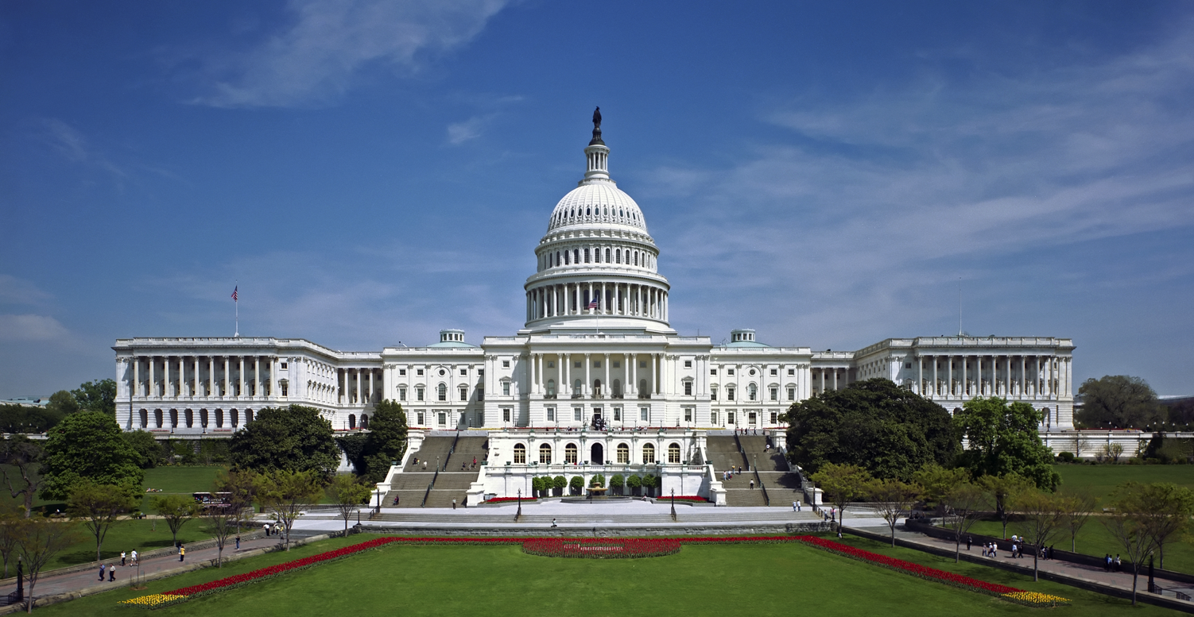
But we also have to think about this!

Slide 7
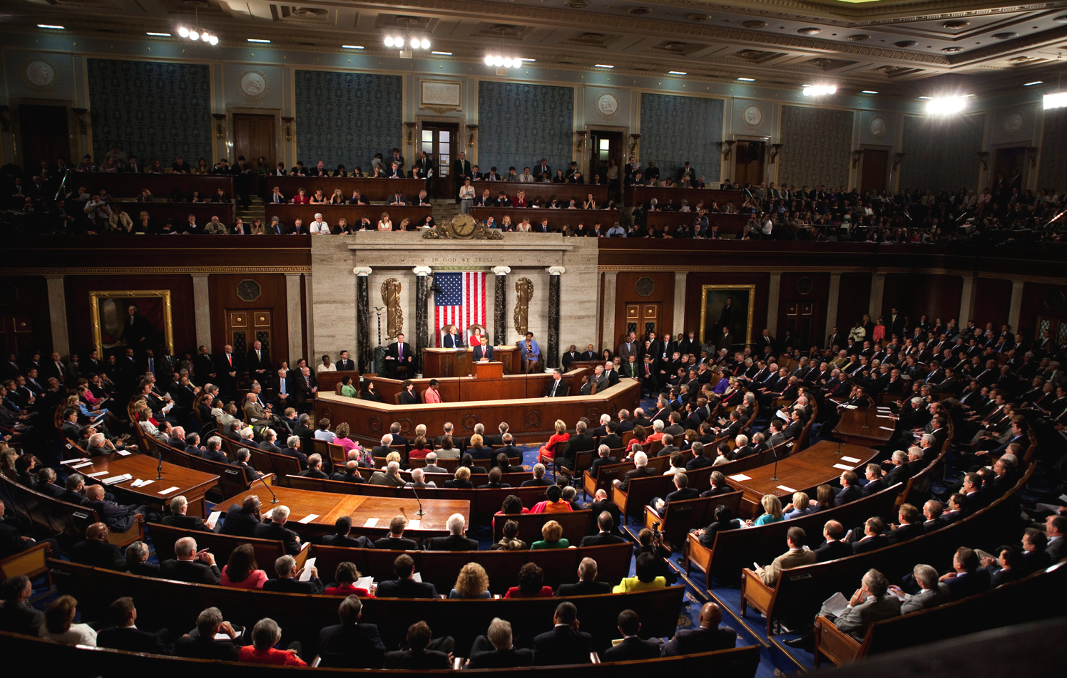
That’s 535 more people to worry about
Notes:
This is a picture from Obama’s address on healthcare to both houses of Congress
Whether it’s President Sanders or President Trump, no major changes to our healthcare system (let alone single-payer) are possible
Really all we need is a 2/3 majority in both houses, and then we don’t care who’s standing at that podium up there
Piece of cake? Right? Guys?

Slide 8
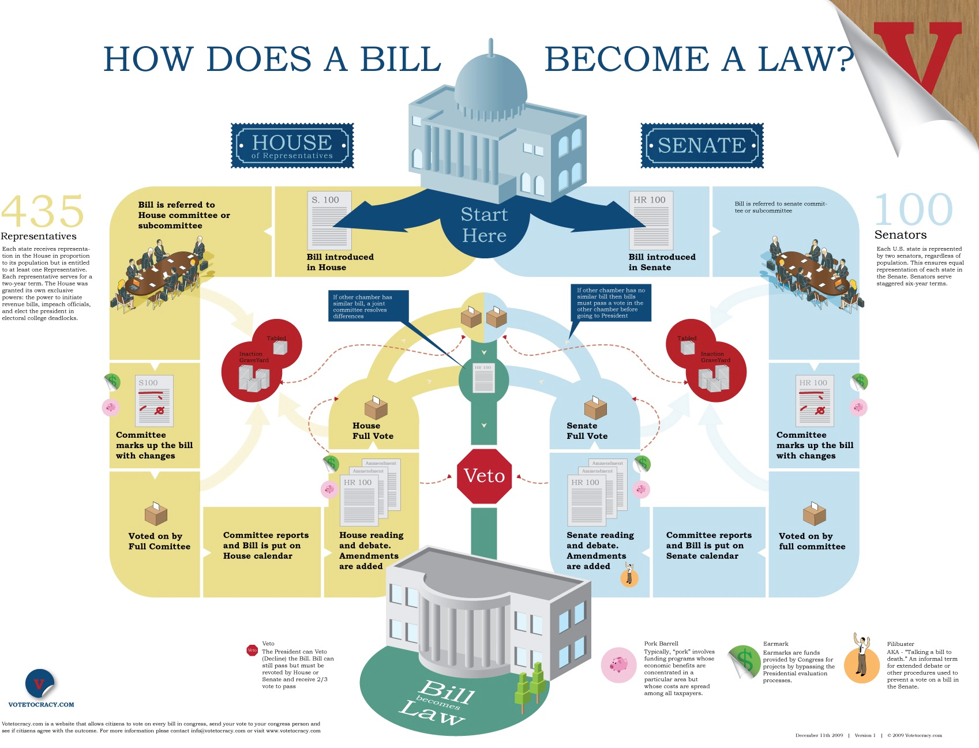

Slide 9
A Quick Review
What can SNaHP do
Build coalitions and political will to move towards a truly universal healthcare system
Put pressure on candidates and elected officials to support the cause
What SNaHP cannot do
Endorse any candidate
Notes:
We can’t endorse because of our 501(c)3 status
This is a legal limitation
However, it is also an important strategic point

Slide 10
The Savior Complex
Notes:
Too often we think that if just elect the “right” person, then we’ll fix everything
I’m picking on Bernie here to use a current example, but the same thing happened to Obama and others before him
And to Bernie’s credit, he’s specifically disavowed this view of politics
What we do have is an opportunity: the Sanders campaign has all of a sudden made single-payer a live option again
It’s our turn to pick up the ball

Slide 11
Goals for 2016
Build political will in support of single-payer
Increase the number of single-payer supporters in the House and Senate (the White House would be nice too!)
Increase election discourse around single-payer
Increase and maintain public interest
Have every active chapter engage in one of our campaigns

Slide 12
Strategies
Bird-Dogging
Legislative Visits and Advocacy

Slide 13
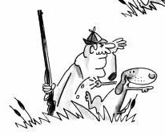
Bird-Dogging
From the OED:
Bird-dog: n. a gun dog trained to retrieve birds
Eg. In Amer. Speech (1960) Bird-dog, a dog which accompanies a bird-hunter for the purpose of scenting the game and picking it up after it falls
Target.
You.
Issue or demand.
Notes:
You are the dog
The bird is the issue or the demand
The politician is the hunter

Slide 14
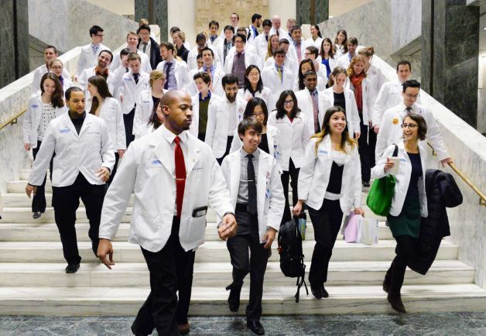
Lobby Visits
2014 PNHP NY Metro Lobby Day
Notes:
Visiting a legislator to get them to support a specific goal
Ex. sponsor HR 676, state bills, etc

Slide 15
Who are our targets?
Presidential candidates
US Senate and House
State legislatures
Notes:
Getting exposure on presidential candidates is great, but fortunately or unfortunately we know exactly how our candidates feel about single-payer
Obviously they’re also a lot less accessible (although if you have a hook up to get me a visit with Obama you just lemme know)
At the end of the day, we simply need more single-payer supporters in Congress for any of this to matter

Slide 16
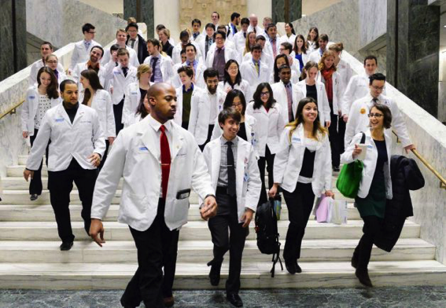
A cycle of engagement
Notes:
Advantage of bird dogging
Get public commitments from officials when they’re at their most vulnerable
Then you follow up with them when they get into office
“So Senator Smith, when you were running for office you said that you would support single-payer. Well?
Outcomes
Yes of course I’m so down
Uhhh wellll uhhhhh
JK LOL
Political advocacy is not a one shot deal- need to continuously engage
Now is a great time to start

Slide 17
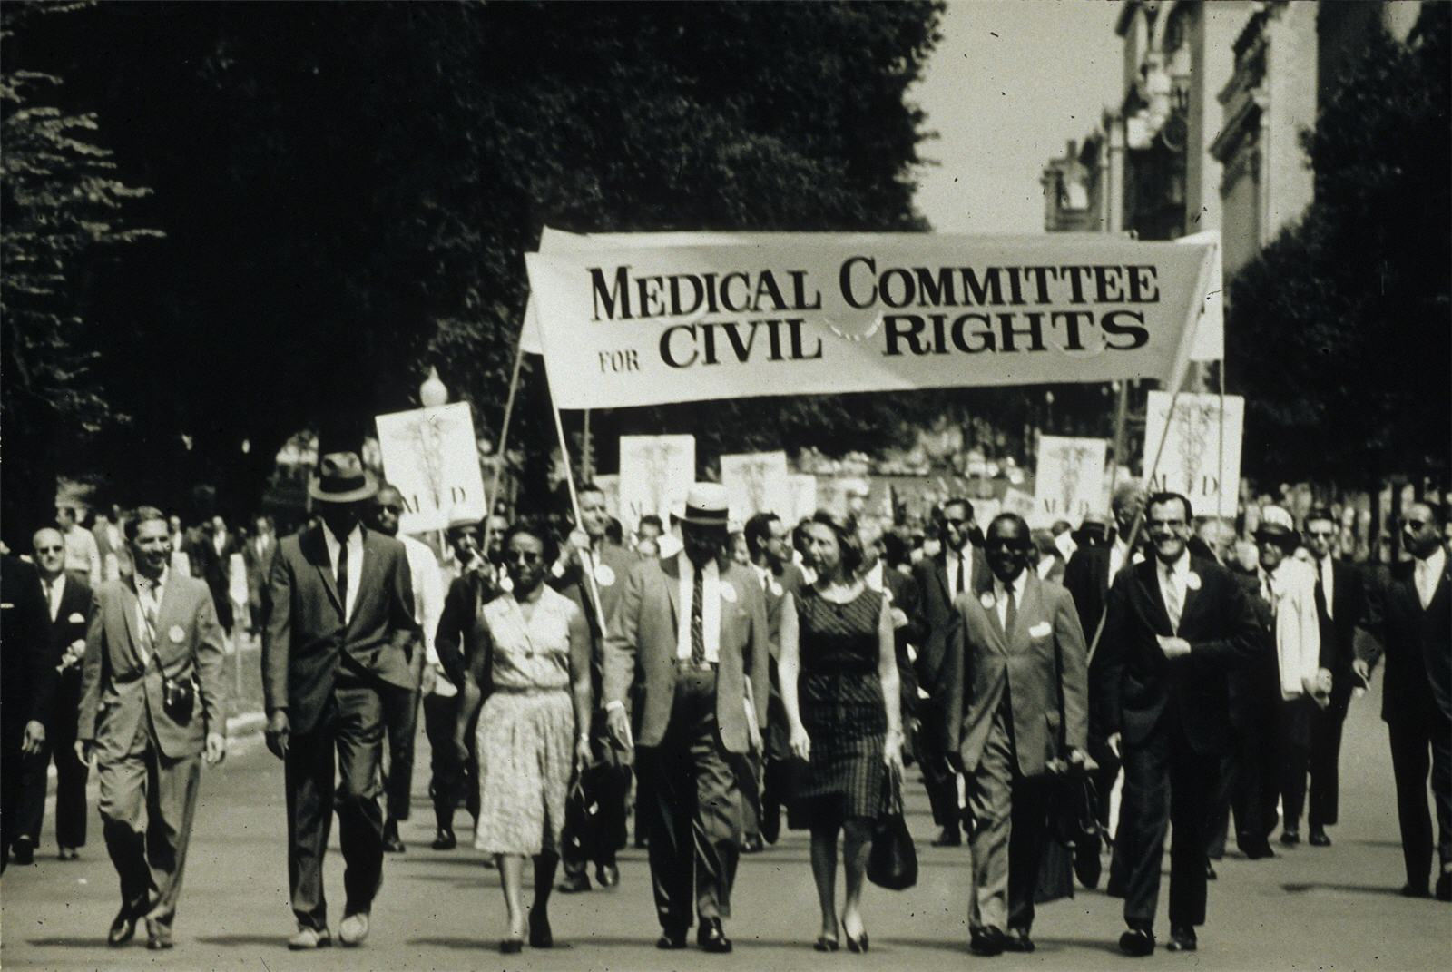
Student Movements Work
Notes:
Quentin Young and other students at Cook County Hospital

Slide 18
What’s next?
Learn a skill: Bird-dogging or lobbying
Try to split your chapter equally among the sessions
Regional planning sessions
We’ll come back together to plan our strategies for the rest of the year

